Slide 1

STUDY CROSSING
Group 1: Anastasia, Steven, Richardson, Jeannie, Jia Zhi, Yuhan, Yufei, Priya, Xian Hao, Ren Wei, Jun Jie
Supervisor:
Assoc Prof Chua Hock Chuan

Slide 2
01
02
ONLINE LEARNING
STUDY CROSSING
03
04
GAME DESIGN
IMPLEMENTATION
05
06
FUTURE WORKS
Q&A
Current Issues
Existing Technology
Project Goals
Main Feature
Trailer
Game Flow
Softwares Demo
Limitations & Plans
Shoot away!

Slide 3
01
ONLINE LEARNING

Slide 4

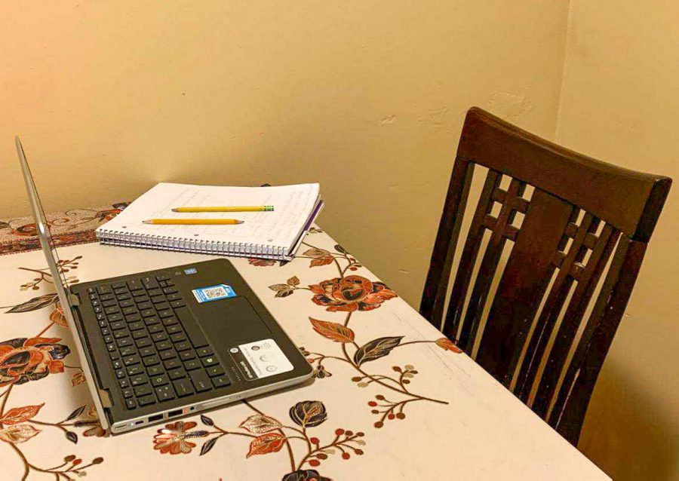
THIS IS YOU

Slide 5



GUIDING PRINCIPLES
CHANGE

Slide 6



CURRENT APPs
MICROSOFT TEAMS
ZOOM
ANIMAL CROSSING
Video conference
Video conference
Game

Slide 7
02
STUDY CROSSING
INTRODUCING

Slide 8

AIM
“Make online learning more engaging”

Slide 9
TARGET: PRIMARY SCHOOL STUDENTS
AGE: 12
LEVEL: Primary 6
LIKES: Playing with friends
XIAO LI

Slide 10



MAIN FEATURE
Conduct an online lesson
in a 3D classroom

Slide 11

TRAILER

Slide 12
03
GAME DESIGN
Game Flow

Slide 13
Game Flow (Block Diagram)
Create /
Log In
Account
Present Lesson Materials
Signal start and end of lesson
Teacher
Create /
Log In
Account
(if currency sufficient)
Buy In-game items
Control avatar movement
Student
Chat (text/voice)
Interact via emotes
Select Avatar

Slide 14
04
IMPLEMENTATION

Slide 15

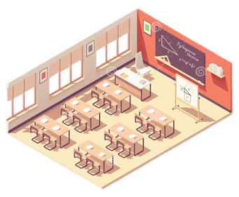




3D Classroom
Characters
Multiplayer Networking
WebView Component

Slide 16
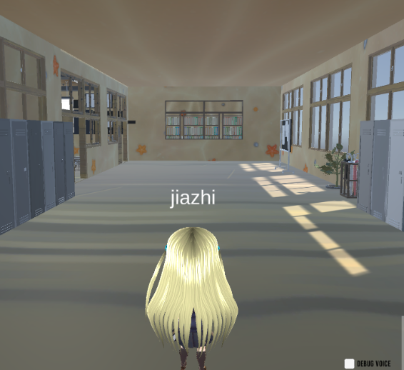
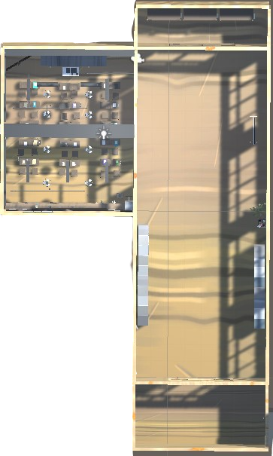
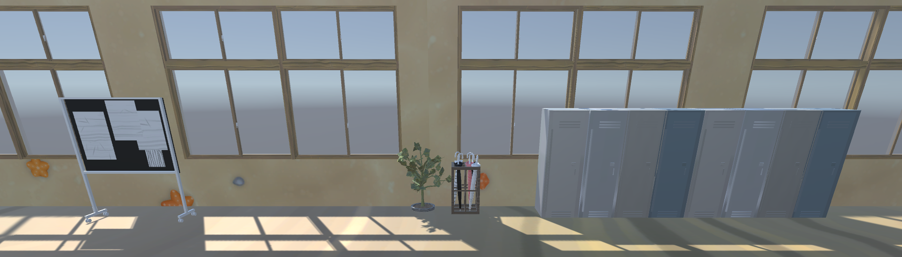
3D Classroom
Spawning Point
Hallway

Slide 17
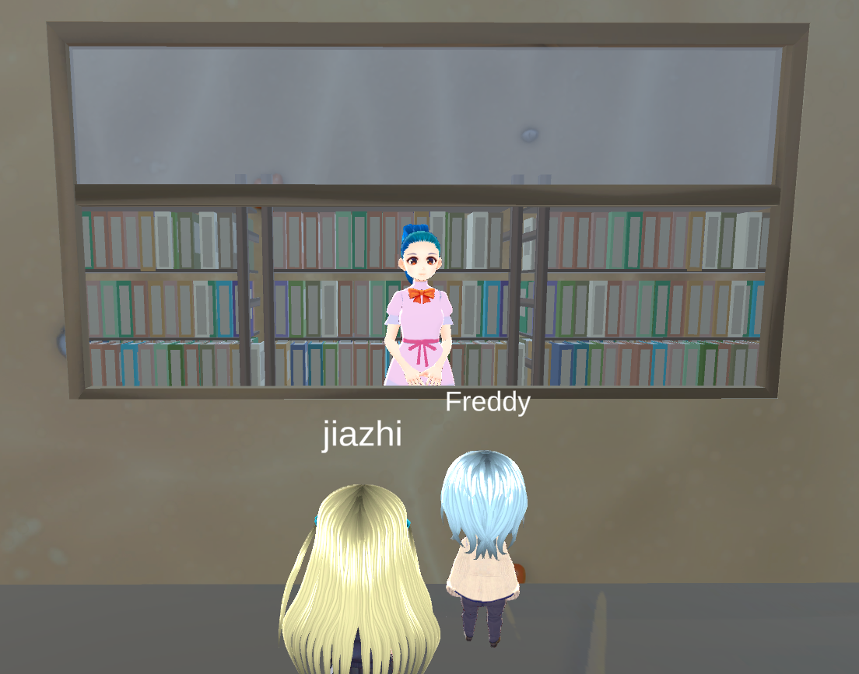
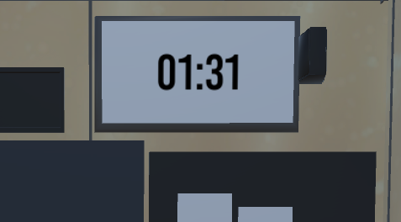
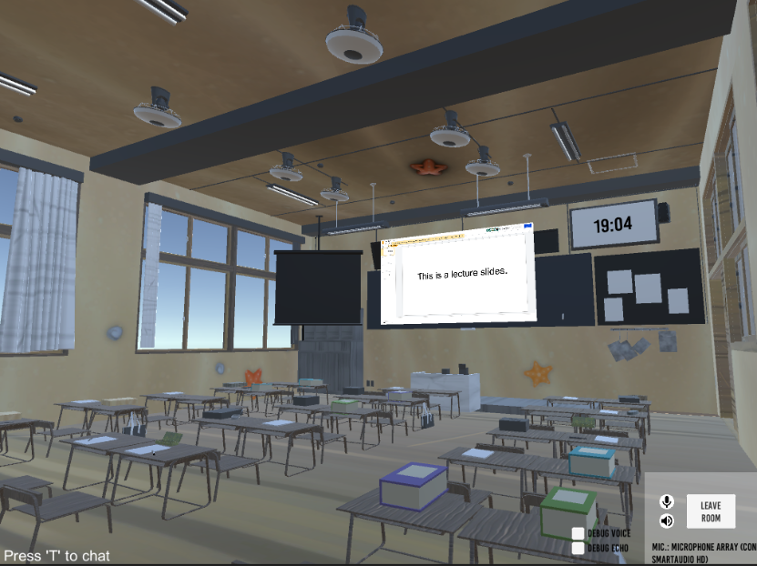
3D Classroom
Clock
Shop
Classroom

Slide 18
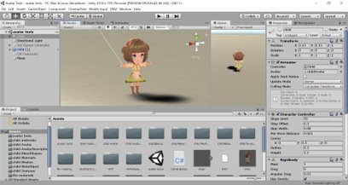

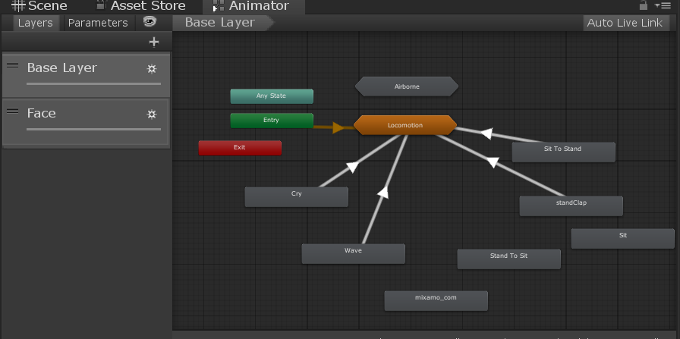
Characters
Importing Model to Unity
Character Animations in Unity

Slide 19










Characters
Models
Animation

Slide 20
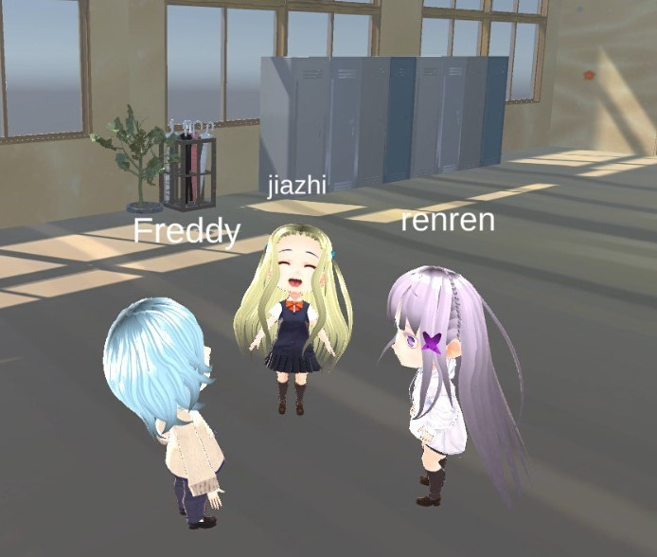
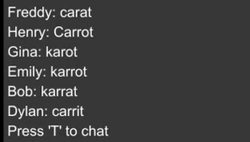
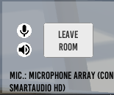
Multiplayer
Characters Interaction
Text Chat
Voice Chat

Slide 21
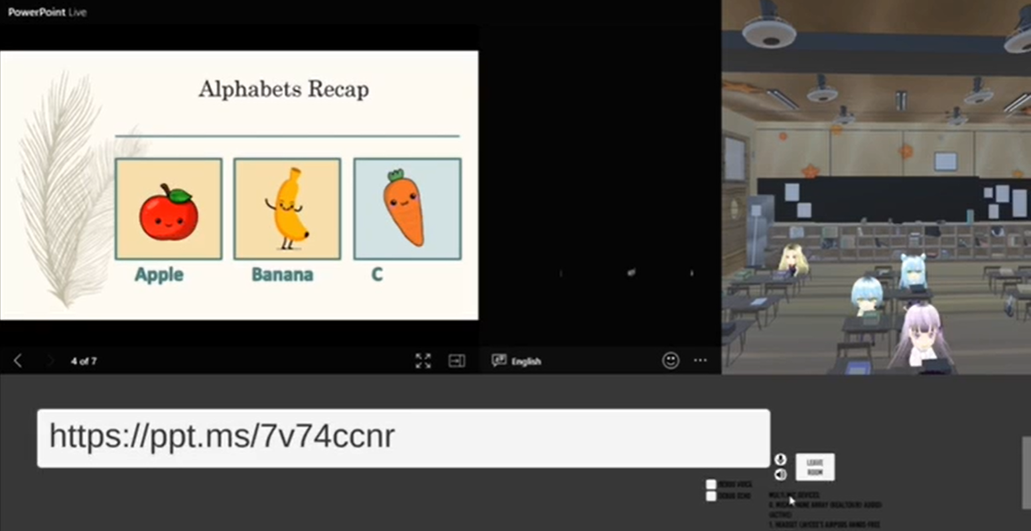
WebView
Teacher’s POV

Slide 22
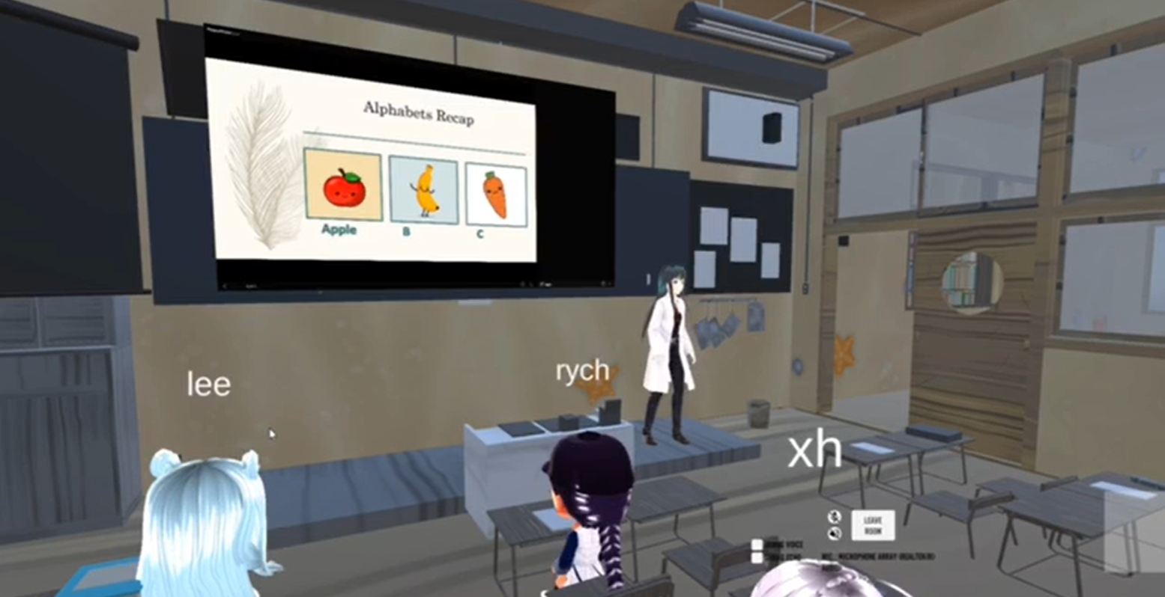
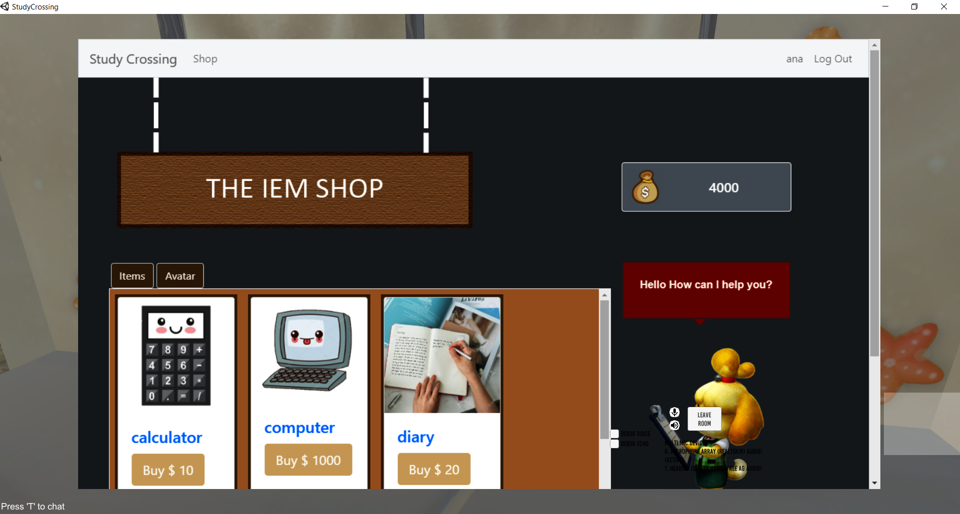
WebView
Student’s POV (Slides)
Student’s POV (Shop)

Slide 23



Website
Python - Flask
SQLite
Microsoft Azure Virtual Machine (VM)

Slide 24
Database
Table: Player
playerId | INTEGER AUTOINC (PK)
username | TEXT UNIQUE NOT NULL
password | TEXT NOT NULL
currency | INTEGER DEFAULT 0
roomName | TEXT DEFAULT classroom
Table: PlayerItem
playerItemId | INTEGER AUTOINC (PK)
playerId | INTEGER NOT NULL
itemId | INTEGER NOT NULL
1
*
*
1
Table: Item
itemId | INTEGER AUTOINC (PK)
itemName | TEXT UNIQUE NOT NULL
Table: ShopItem
shopItemId | INTEGER AUTOINC (PK)
itemId | INTEGER NOT NULL
ItemPrice | INTEGER DEFAULT 0

Slide 25
DEMO: Let’s see how it works!

Slide 26
05
FUTURE PLANS
Limitations and future plans

Slide 27
FUTURE PLANS
INTEGRATION
MORE FEATURES
OPTIMISATION
Integrate with
Zoom / Microsoft Teams
Access lesson materials
Animations
More interesting map (eg. Library)
More efficient use of Unity Engine and the libraries/assets
EXPERIENCE
COST / ENTERPRISE SOFTWARE
TIME

Slide 28

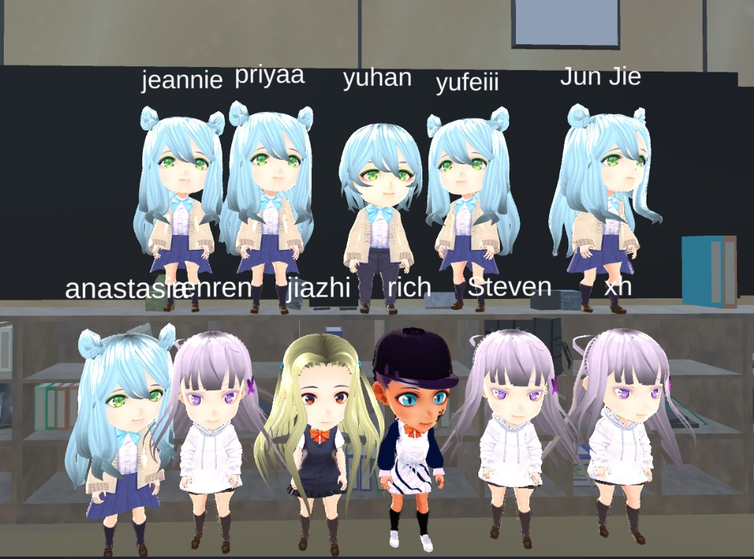
Q&A
The Crew
Shoot away!

